Slide 1

E-Commerce Customer
Segmentation & Prediction
- Mr . Vedant Jadhav

Slide 2
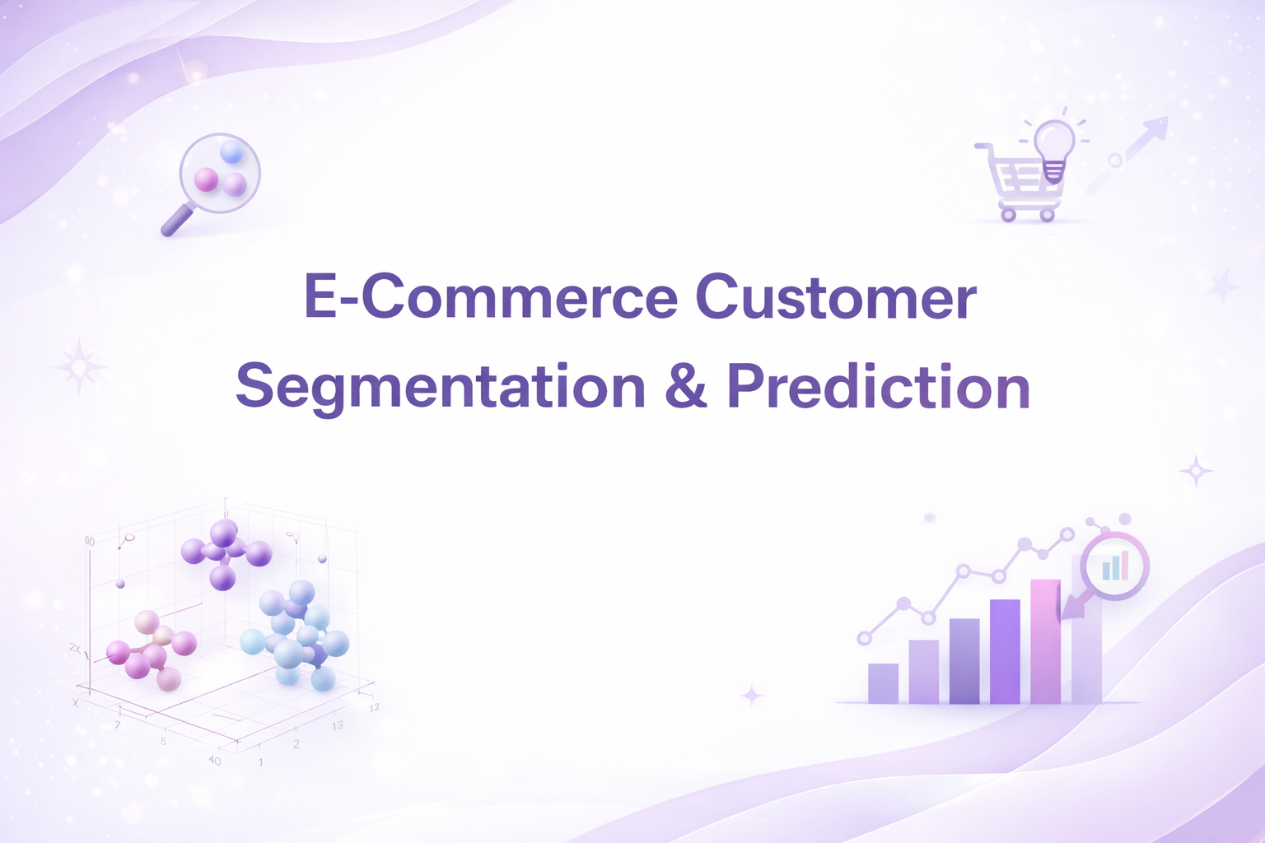

Slide 3

01
INTRODUCTION TO THE PROBLEM

Slide 4
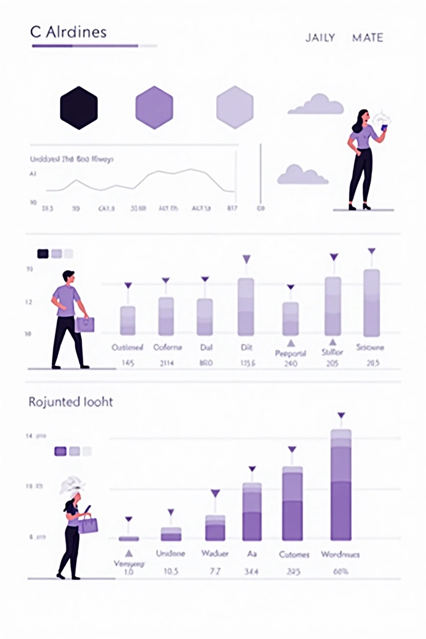
Problem Statement
Industry Context: E-commerce has revolutionized retail by generating massive volumes of transactional data daily. However, most businesses fail to leverage this data effectively to understand customer behavior, preferences, and patterns. This represents a critical missed opportunity for competitive advantage and business growth.
Detailed Challenges:
Identify High-Value Customers
Not all customers are equally valuable. Businesses cannot distinguish between champions, loyal customers, and at-risk segments, leading to misallocated resources.
No Systematic Approach to Predict Value
There is no mechanism to predict customer lifetime value (CLV) or segment new customers automatically, making scalable personalization impossible

Slide 5

02
WHY CUSTOMER ANALYSIS & MACHINE LEARNING IS IMPORTANT

Slide 6

Business Impact & Strategic Value
Advanced analytics transforms raw customer data into actionable insights that drive competitive advantage and sustainable business growth. Machine learning makes this possible at scale.
Key Business Drivers:
Understand what motivates each segment to make purchases.
Discover hidden patterns and relationships in customer data.
Targeted Marketing:
Churn Prevention:
Customer Understanding:
Identify distinct customer groups with unique behaviors, preferences, and purchasing patterns.

Slide 7

03
PROJECT OBJECTIVES

Slide 8
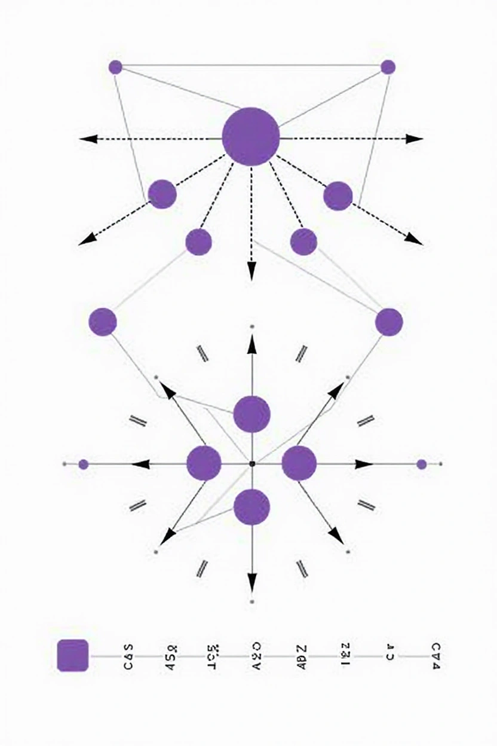
PROJECT OBJECTIVES
1
Segment Customers Effectively:
2
Apply RFM (Recency, Frequency, Monetary) analysis to quantify customer value.
3
Use K-Means clustering to identify distinct customer groups.
4
Create interpretable segments aligned with business strategy.
5
Build Predictive Model:
6
Enable Strategic Engagement:

Slide 9

04
PROJECT SCOPE & FEATURES

Slide 10

System Applications
This project is designed for use by:
1
Marketing departments for campaign planning and execution.
2
Customer service teams for personalized support strategies.
3
4
Sales teams for account management and upselling.
Business strategy and leadership for resource allocation.

Slide 11

05
DATASET DESCRIPTION

Slide 12

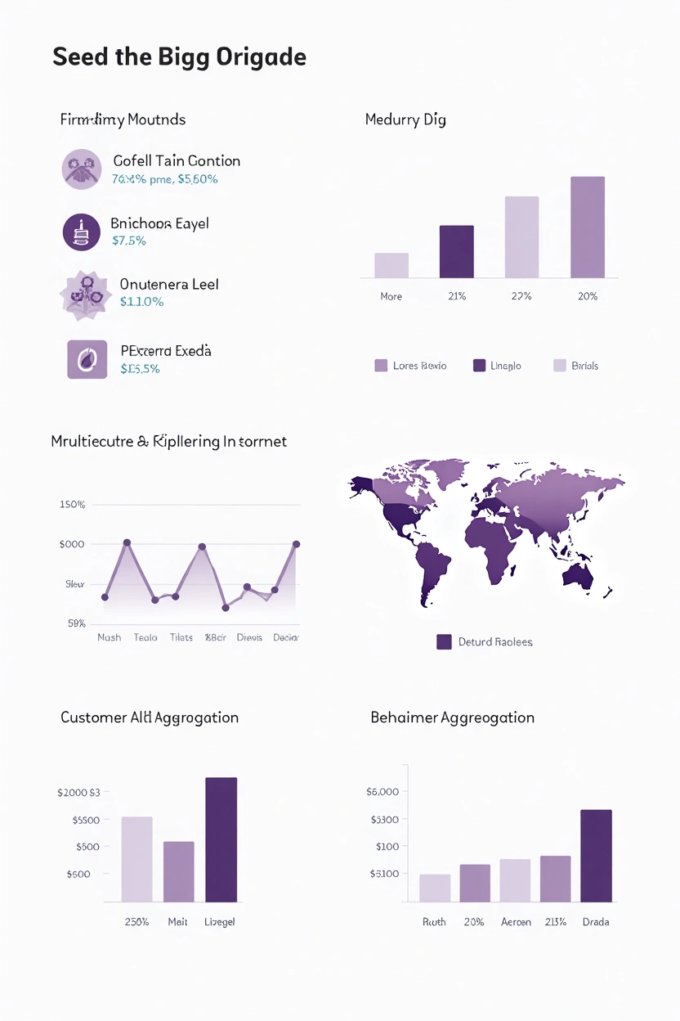
Data Source
E-commerce transaction database containing comprehensive customer purchase history and behavioral patterns. Data spans multiple transaction types across product categories.
Nature of Data
Type: Transactional data with temporal, monetary, and behavioral dimensions Volume: Multiple years of transaction history Granularity: Transaction-level detail aggregated to customer-level metrics

Slide 13
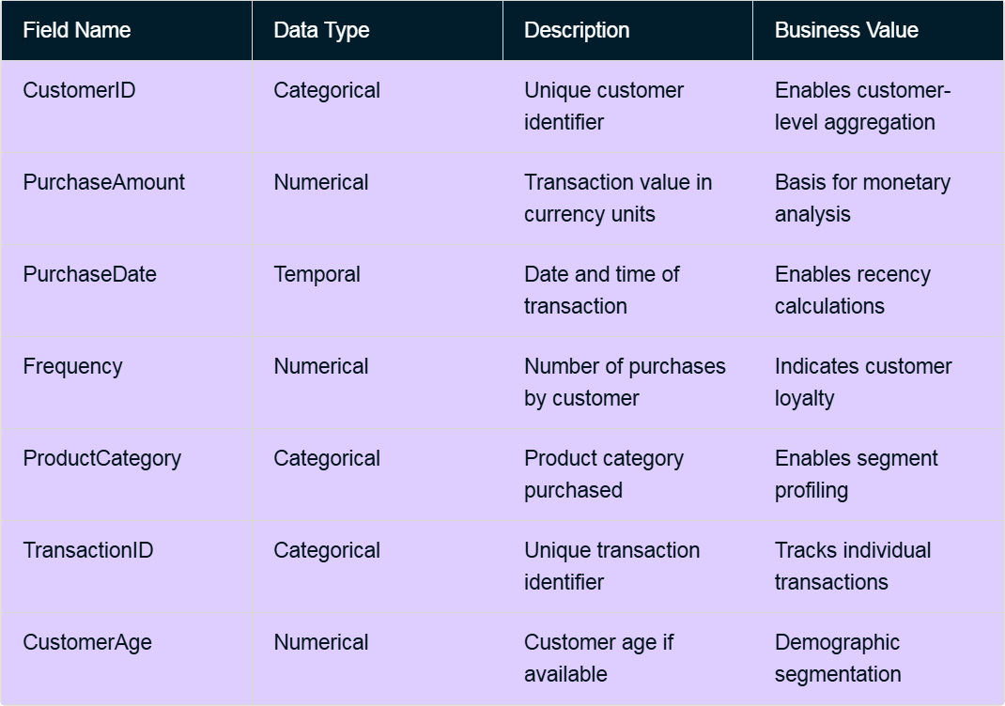
Key Dataset Fields

Slide 14

06
DATA PREPROCESSING & CLEANING

Slide 15
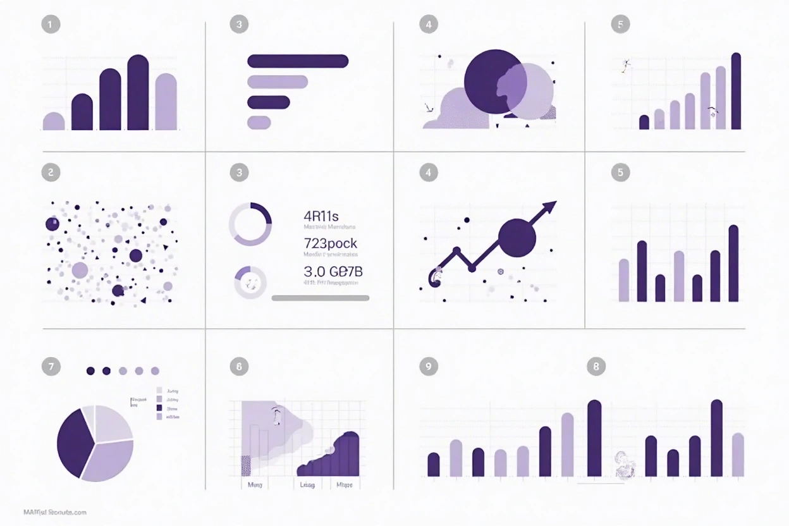
DATA PREPROCESSING & CLEANING
Objective: Transform raw, messy transactional data into clean, analysis-ready features for machine learning.
Handling Missing Values: Identified and treated null values using appropriate imputation strategies
Removing Duplicates: Eliminated duplicate transaction records
Outlier Detection: Identified and handled anomalous purchases using statistical methods
Date Normalization: Converted date formats and calculated relative recency periods
Feature Scaling: Standardized numerical features for model compatibility

Slide 16
07
EDA-Exploratory Data Analysis

Slide 17
EDA-Exploratory Data Analysis
Exploratory Data Analysis (EDA) is the process of exploring a dataset to understand its structure, main patterns, relationships, and data quality issues before building models.
What is EDA?
EDA uses summaries (statistics) and visualizations to:
Understand distributions and ranges of variables.
Detect missing values, outliers, and anomalies.​
Check assumptions for later modeling.​
Discover relationships between variables and guide feature engineering and model choice.
You can think of EDA as “data debugging + data storytelling” done before any serious modeling.
Types of EDA (high level)
Commonly we divide EDA into:
Univariate analysis: one variable at a time.
Bivariate analysis: relationship between two variables.
Multivariate analysis: three or more variables together.
Each of these can be done with graphical methods (plots) or non-graphical methods (summary statistics, correlations, tests).

Slide 18
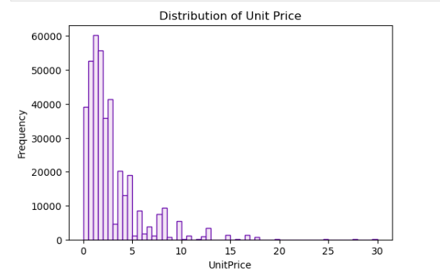
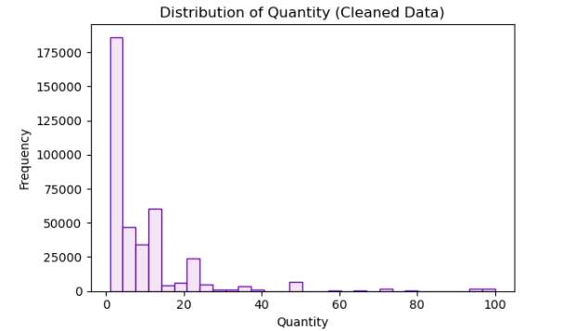
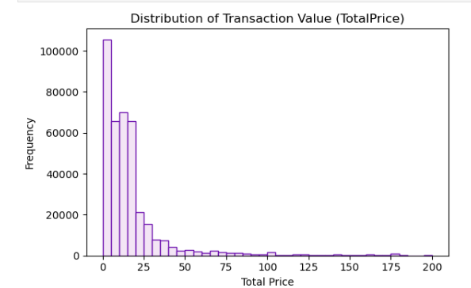
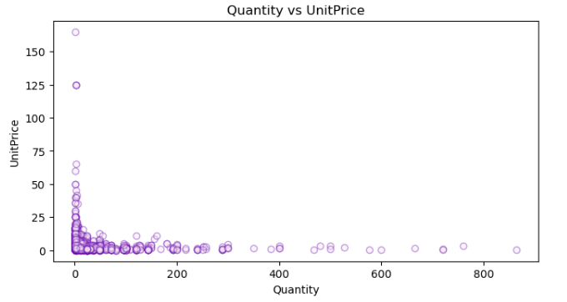
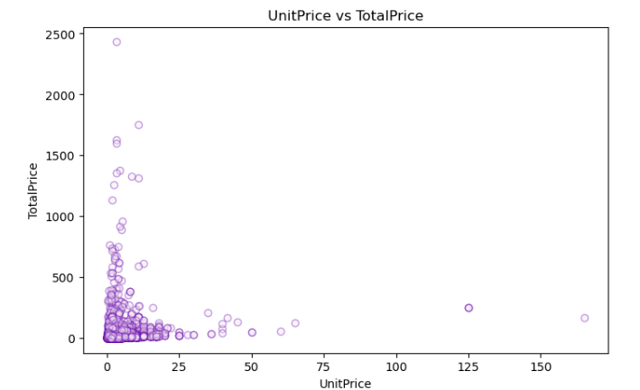
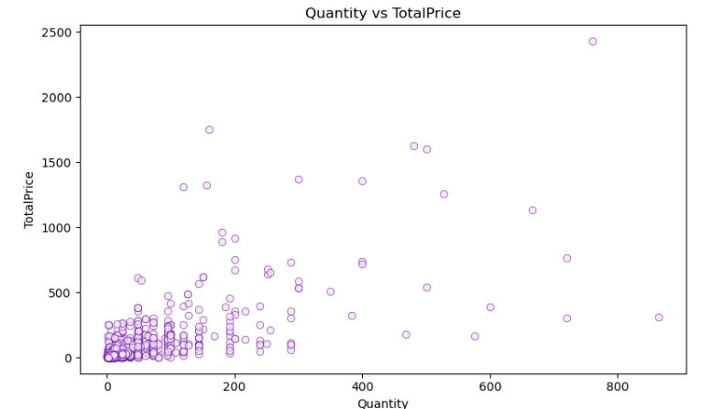
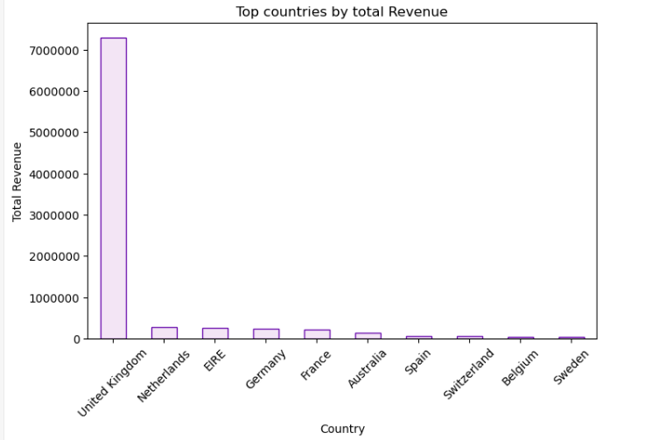
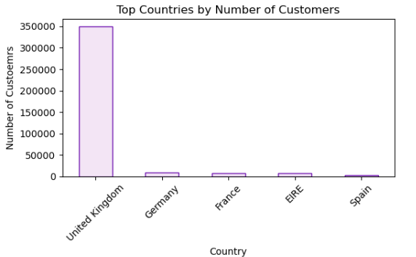
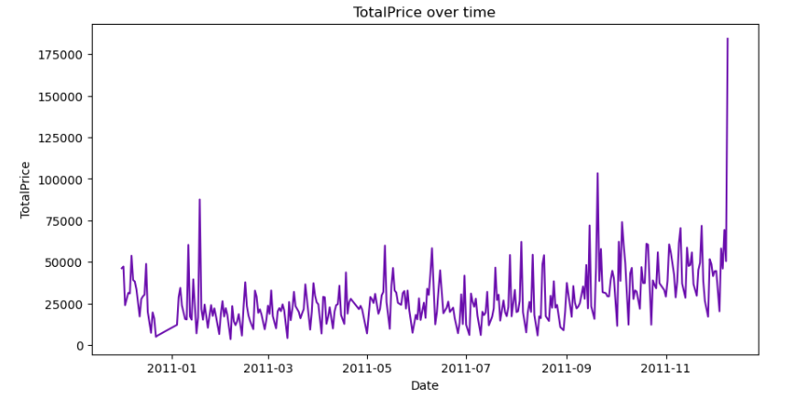
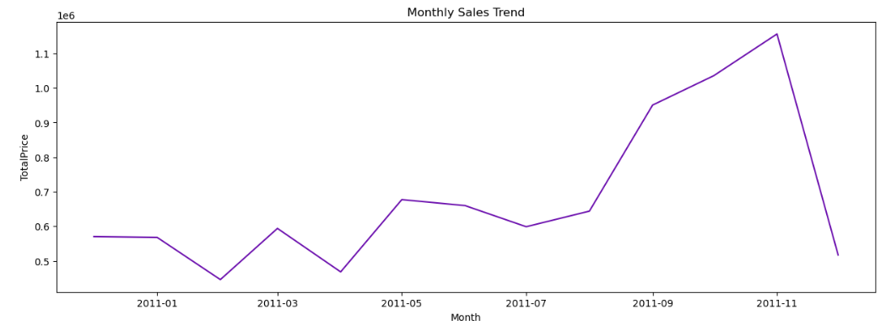
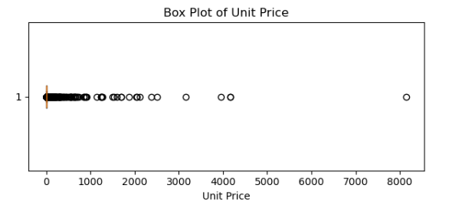

Slide 19
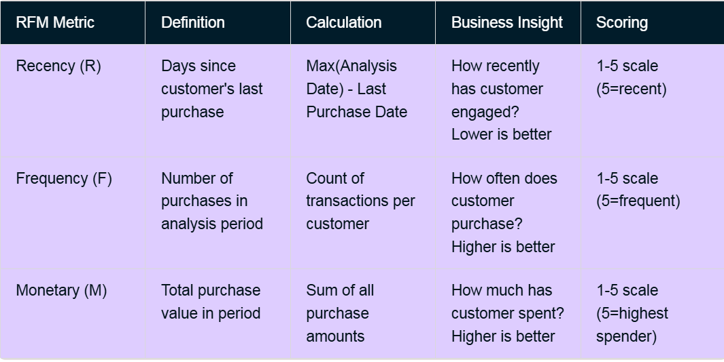
RFM Analysis: Definition & Importance
RFM (Recency, Frequency, Monetary) is a behavioral analysis framework that segments customers based on three key transactional metrics. It's one of the most effective and interpretable customer segmentation approaches.
RFM Components Explained

Slide 20
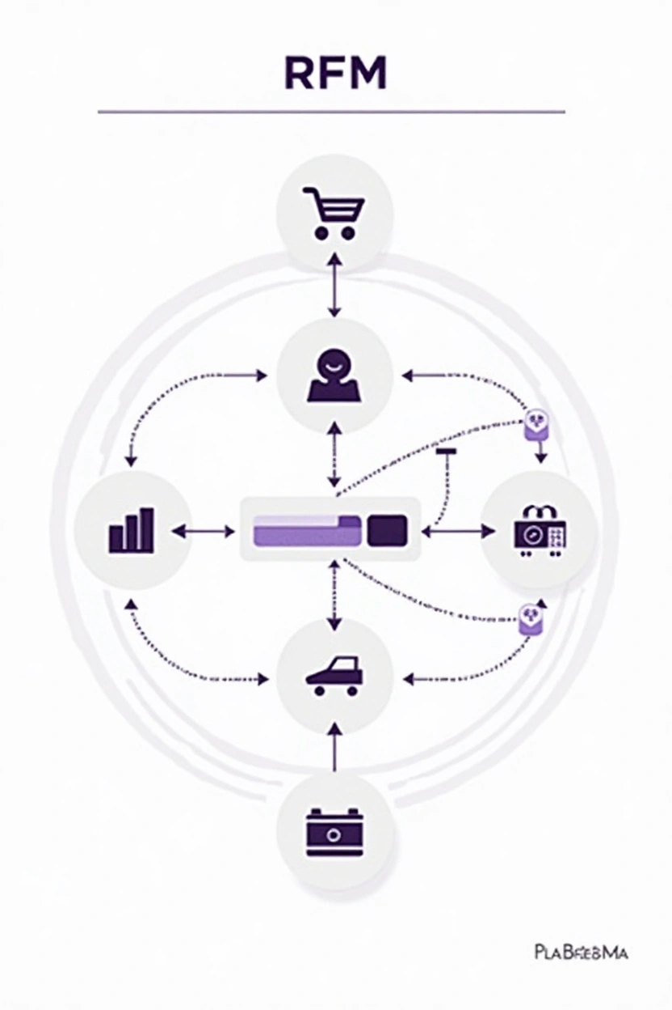
Why RFM in This Project?
Interpretability
Results are easily explained to business stakeholders without technical background
Simplicity
Requires only transaction data; no complex features needed
Efficiency
Computationally lightweight yet highly effective.
Business Alignment
Directly maps to actionable business metrics and strategies.
Robustness
Proven approach used by leading e-commerce and retail companies globally.
Segmentation Power
Naturally creates meaningful customer groups aligned with business value.
Predictability
Strong correlation between RFM scores and customer lifetime value, churn, and campaign response.

Slide 21

08
PROJECT ARCHITECTURE:
Two-Track Project Architecture

Slide 22
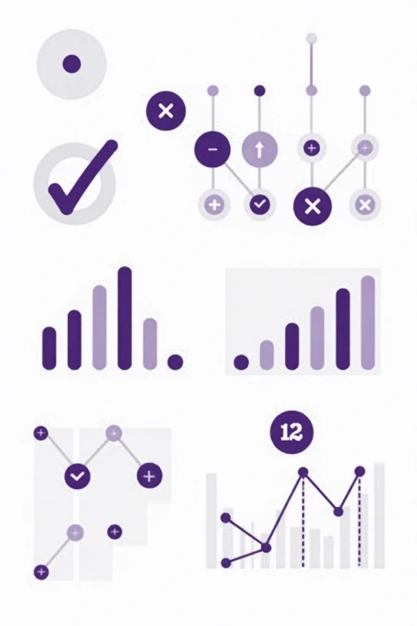
Overview
This project comprises two integrated machine learning pipelines working in parallel to achieve comprehensive customer intelligence
This project comprises two integrated ML pipelines working in parallel:
1: Clustering
Unsupervised learning to identify natural customer groups
2: Prediction
Supervised learning to assign segments to new customers

Slide 23

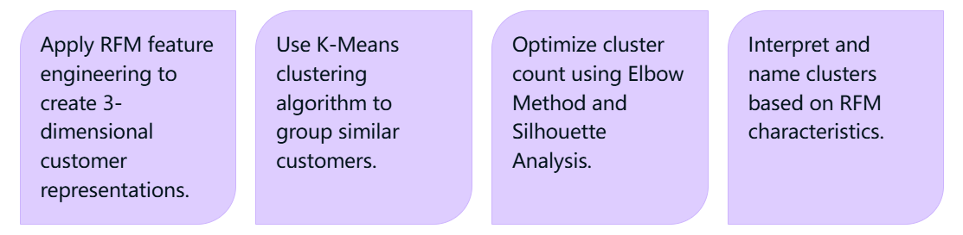
1: Clustering (Unsupervised Learning)
Objective: Identify natural customer groups without predefined labels.
Process:
Output:
Distinct customer segments (e.g., Champions, Loyal, At-Risk, New).
Cluster profiles with mean Recency, Frequency, Monetary values.
Business recommendations for each segment.

Slide 24

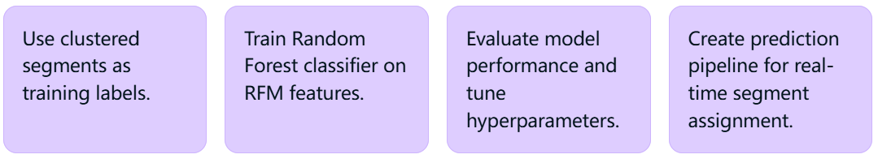
2: Prediction (Supervised Learning)
Objective: Predict segment membership for new customers automatically.
Process:
Output:
Predictive model for segment classification.
Confidence scores for each prediction.
Feature importance insights.
Real-time deployment capability.

Slide 25
09
Work Flow

Slide 26
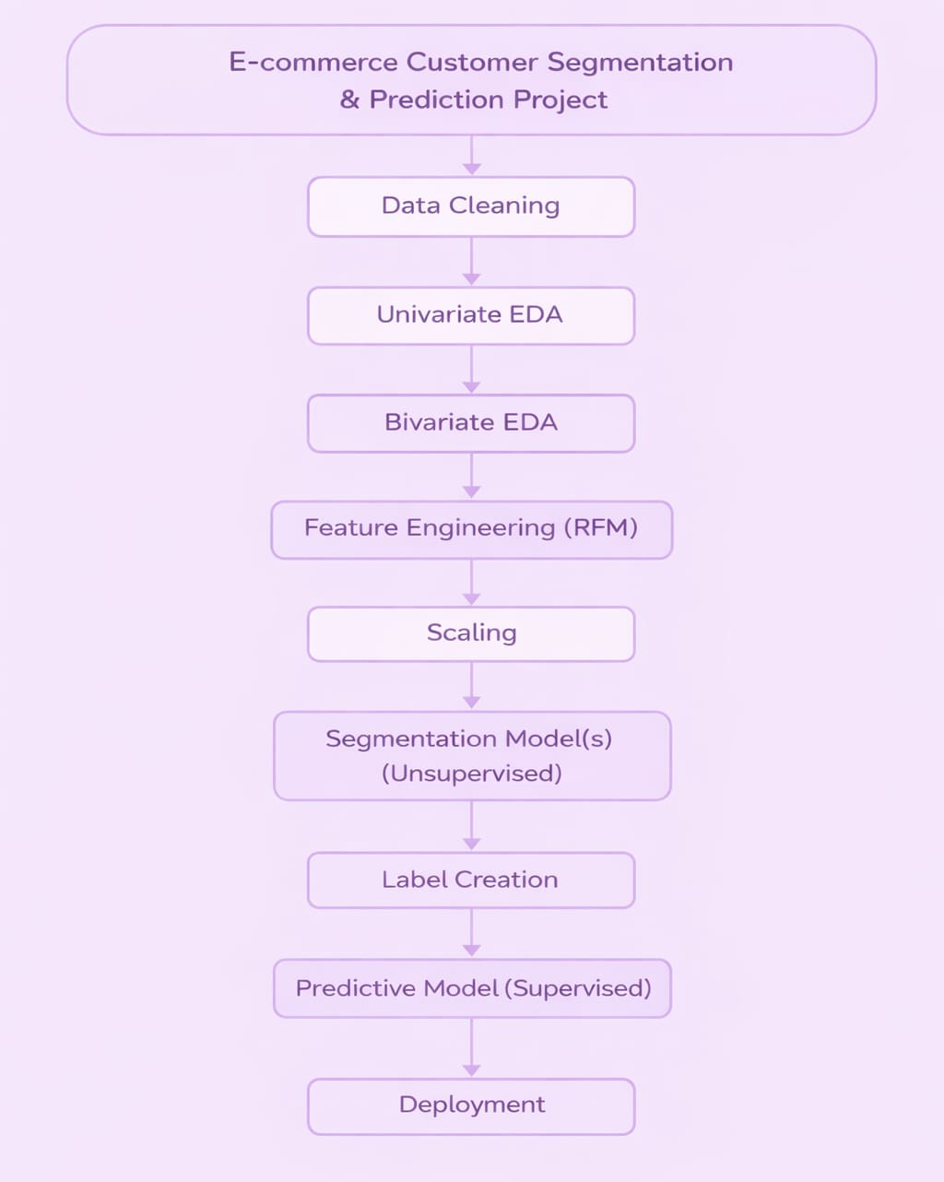
Project Workflow Overview
Project starts with cleaning raw e-commerce transaction data to remove missing, duplicate, and invalid records. Exploratory Data Analysis (EDA) is then performed to understand customer purchasing behavior and transaction patterns. Based on these insights, RFM (Recency, Frequency, Monetary) features are engineered and scaled to prepare the data for modeling. Customers are segmented using unsupervised learning, and segment labels are assigned. Finally, a predictive model is built and deployed to classify customers into appropriate segments for business decision-making

Slide 27
10
Prediction Pipeline

Slide 28
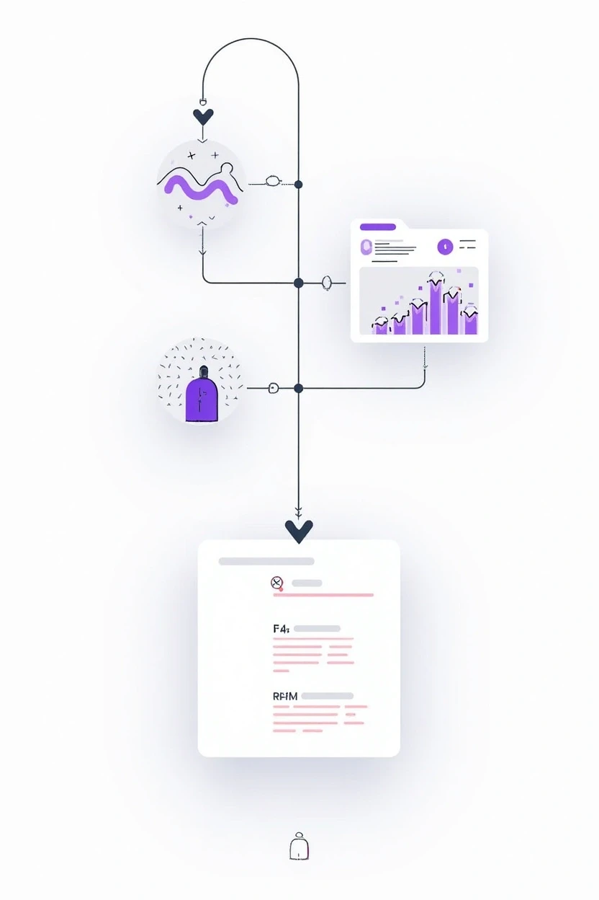
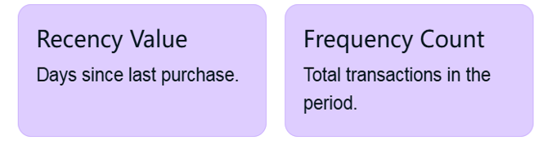
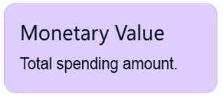
Prediction Pipeline: Inputs & Outputs
Inputs
The model accepts new customer RFM data:

Slide 29
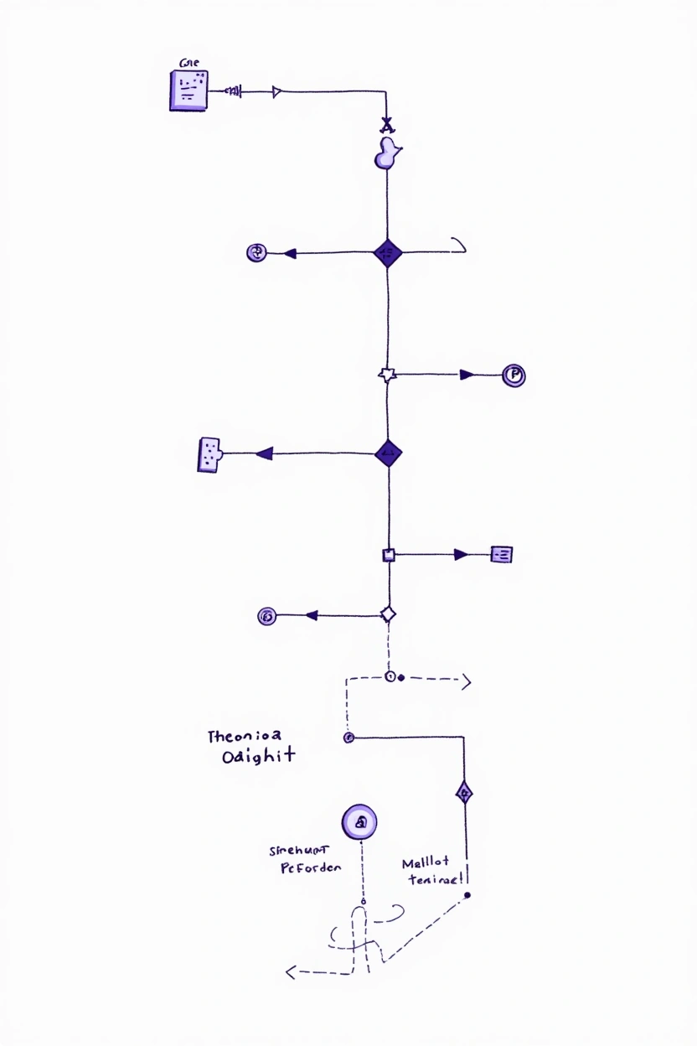
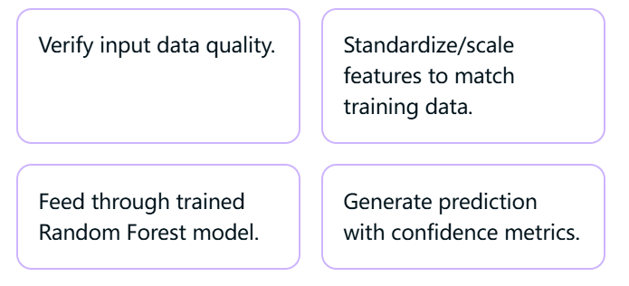
Prediction Pipeline: Inputs & Outputs
Processing

Slide 30
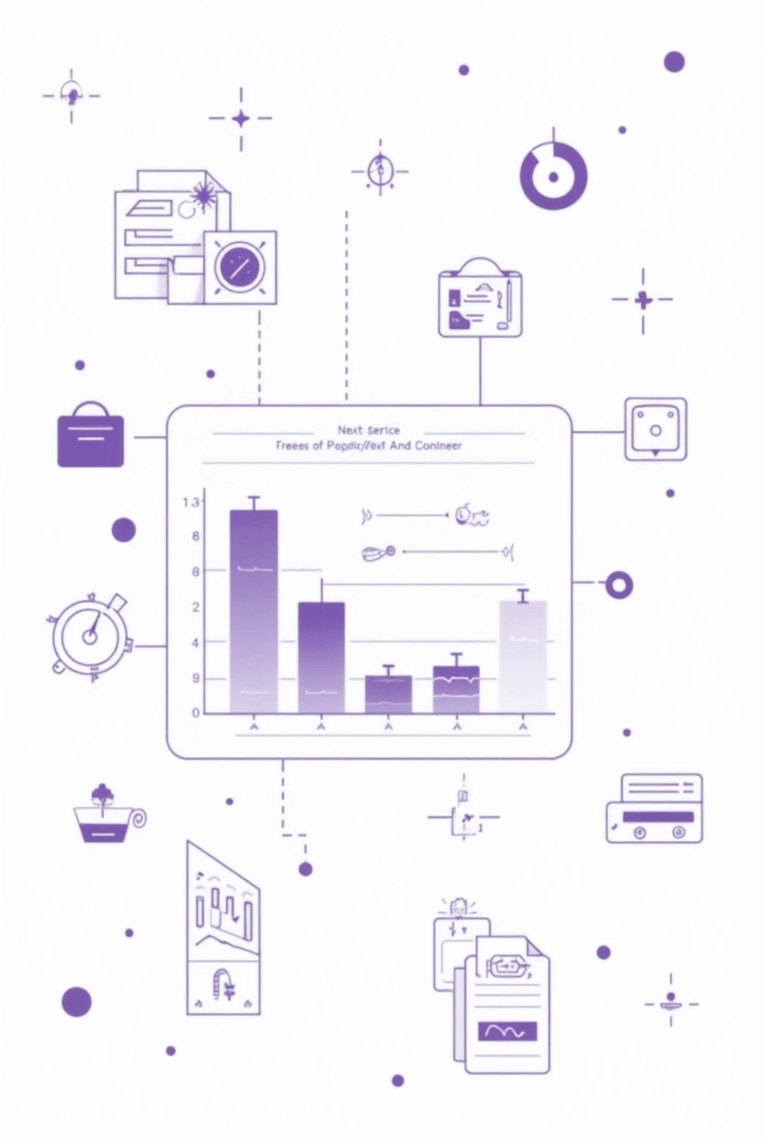
Prediction Pipeline: Inputs & Outputs
Outputs
The model generates actionable predictions:
1.Predicted Segment
Primary segment assignment.
2.Confidence Score
Probability of prediction indicates certainty.
3.Segment Probabilities
Full probability distribution across all 4 segments.
4.Feature Importance
Which RFM metrics most influenced this specific prediction.
5.Next Steps
Specific engagement recommendations.
6.Actionable Insights
Recommended marketing strategies for this customer.

